Slide 1


Medical Device Interoperability
The next chapter of integration
Mark Smith, Business Development Director
contact@enovacom.com
07764 487301
10th May , 2019

Slide 2

The Issues today

Slide 3
Huge Demand

Slide 4
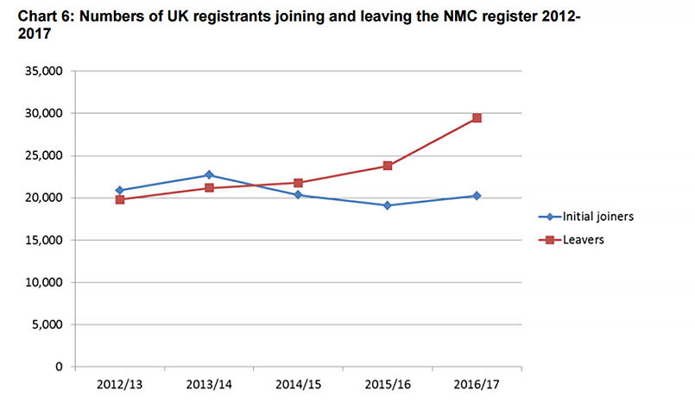
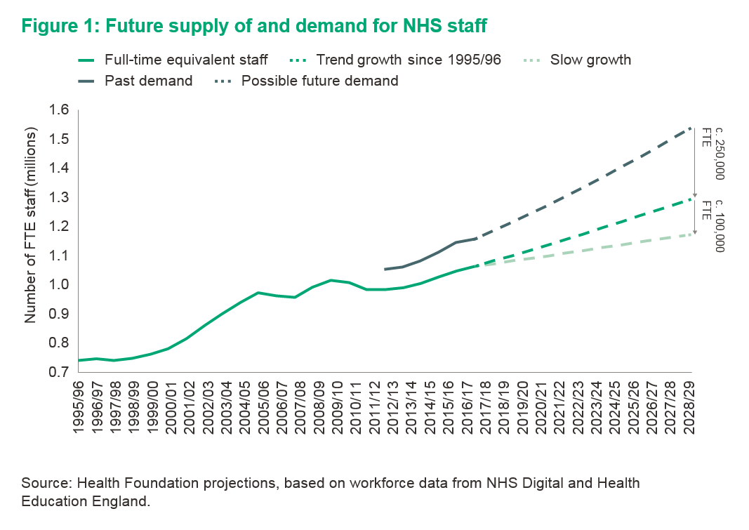
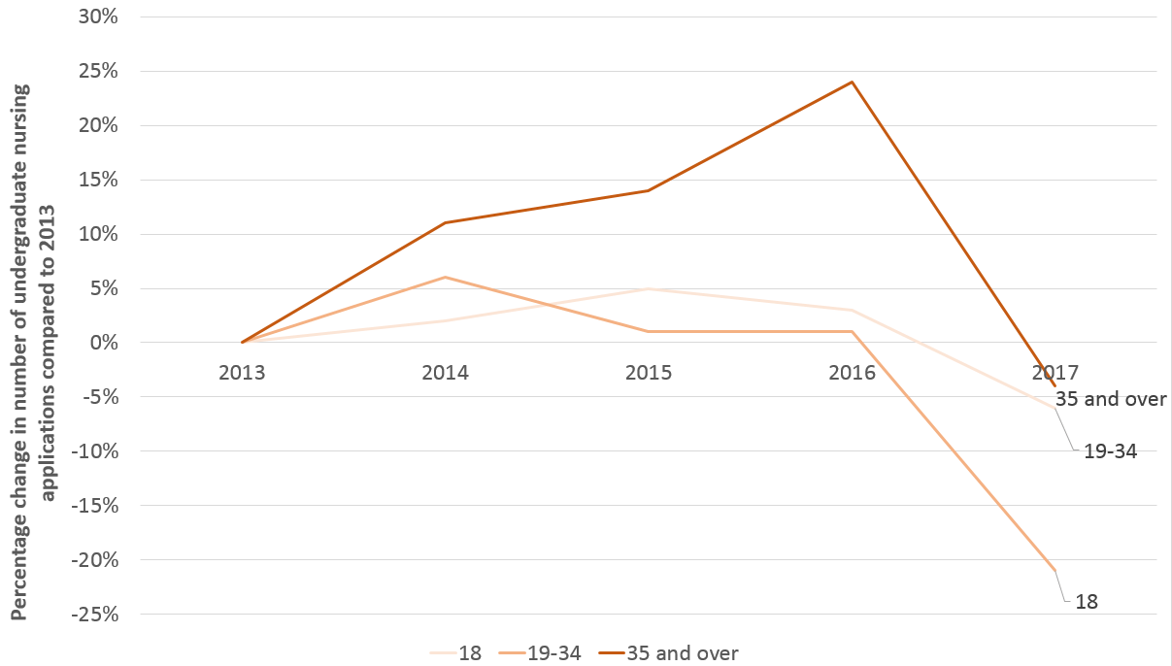
Resources
% Change – No of Undergraduate Nursing

Slide 5
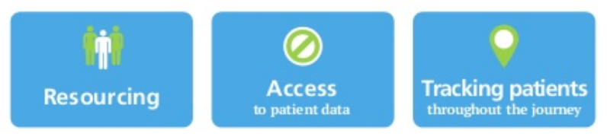
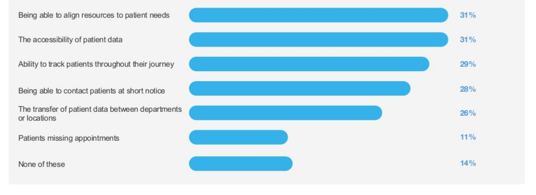
Top 3 Clinical Concerns
TOP 3
Challenges of patient
management
According to a 2016 Lumeon study
Notes:
If we now look at the top three challenges identified by staff today we can see that the major concern is having access of patient data, in real time, with the ability to track patients throughout their episode of care, and the right resources to look after their needs. In each of these cases technology has had a major impact but it has been a long journey, and in my own experience changing the culture in the healthcare profession is very difficult, it is important to ensure the technology is easy to use as busy clinicians dont have the time to second guess how to use it, and in fact successful developers of new software work with clinicians to ensure they thoroughly understand workflows and follow the exact In the next two slides we will identify the type of software technology that has had widespread adoption in the NHS,

Slide 6
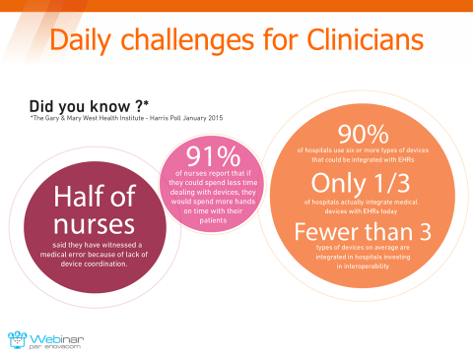
Daily challenges for clinicians
Notes:
Starting from left to right , half of nurses have witnessed a medical error because of the lack of device co-ordination, which essentially means that the patient data is spread between different devices and to collect them all into one place is simply a nightmare. All nurses joined the profession to help people, it must be soul destroying when you know there are so many inefficiencies in their working practices, 91% of nurses interviewed said that want to spend less time fiddling about with machines than dealing with the needs of their patients.
90% of hospitals use Six or more devices that could be integrated to the core EPR system, research shows that only 1/3 of hospitals actually integrate medical devices with their EPR today, fewer that 3 types of devices are integrated in hospitals investing in interoperability, most of these devices are in a ITU / Critical Care setting although most of the data sits in silos in the department. All this means that potentially missing bits or delayed patient information could potentially harm or even cause the death of a patient.

Slide 7
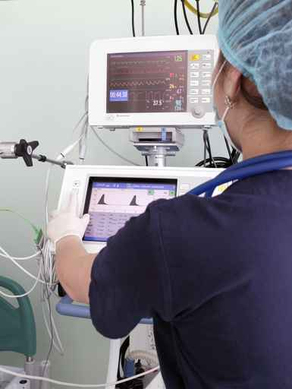
Manual Process Issues
The patient’s vital signs and surveillance data are taken manually and then transcribed or scanned into the patient’s EPR file.
Error prone process
Time consuming
High latency process
Prescribed schedule not always respected

Slide 8
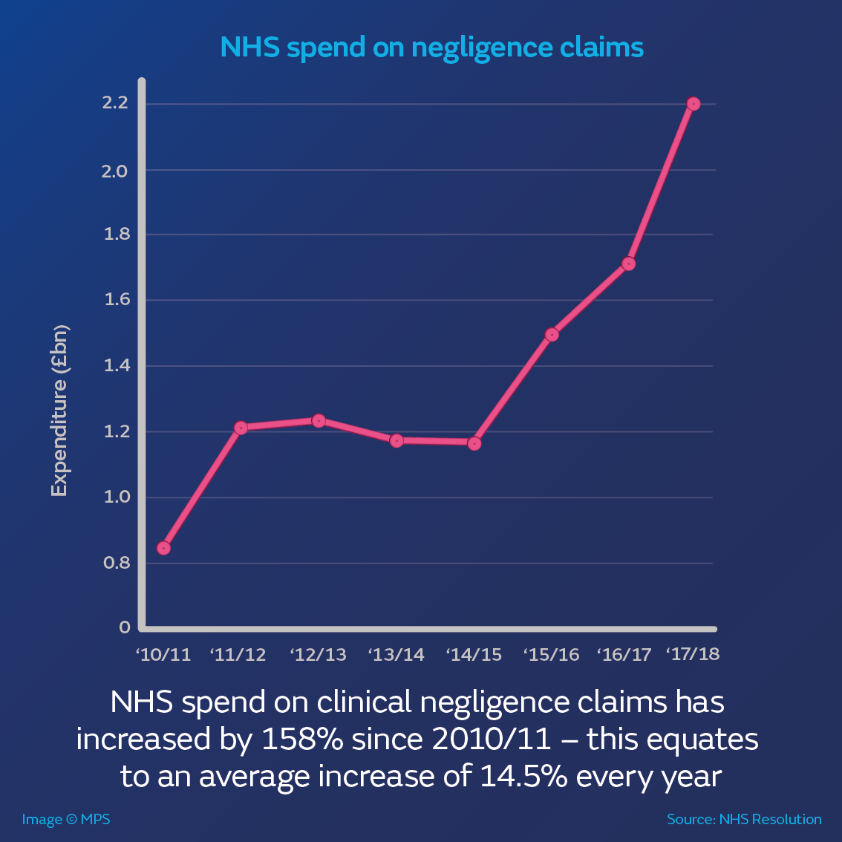
NHS spend on negligence claims
NHS spend on clinical negligence claims has increased by 158% since 2010/11 – this equates to an average of 14,5% every year

Slide 9
Positive Impact of technology

Slide 10
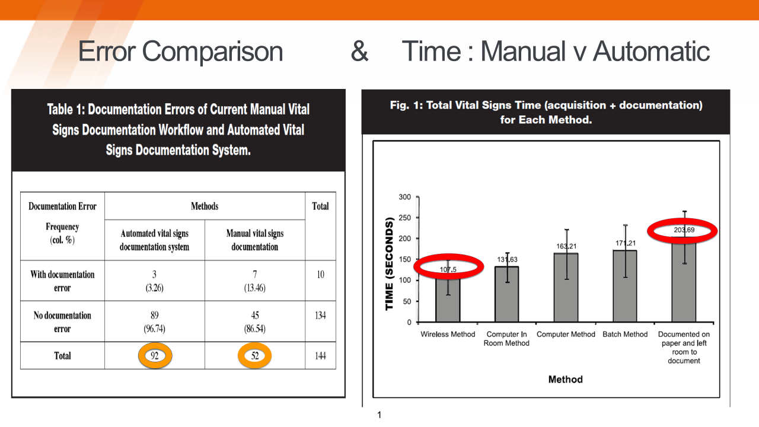
Manual v Automation Collection
Error Comparison
&
Time: Manual v Automatic
Notes:
The next slide aims to show that by automating the care process of the collection of patients vital signs on the left we see that the number of errors are almost reduced by 50% compared to the manual collection of vital signs using pen and paper.
And then on the right, we look at the research that shows the different methods of collection and the time it takes to process the information, if we look at the far right we can see that documenting by hand on paper and then documenting the information on an available computer at a nursing station takes almost twice as long than if we the process was automatically engaged. This is significant when you consider all the pressures we previously presented at the beginning of the slide.
Ok so now that we have covered both the patient outcome and efficiency considerations , lets know see what the staff actually think about their current predicament and what they think will help them

Slide 11

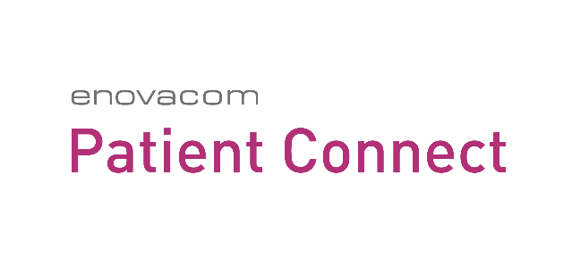
ENOVACOM Patient Connect

Slide 12
Why MDI is important
Automation of vital sign collection means more “time to care”
Reduces the number of errors and misinterpretation: increasing patients safety
Delivering the right care, at the right place, at the right time, with a complete record of the patient pathway episode “care continuum”
Real-time transfer of data to disparate systems, and more data parameters not previously available, allows clinicians to make a better more informed decision.
Explosion of software apps and IOT, eg Wearables, Remote Monitoring Devices as patients are more mobile.
Notes:
So why is MDI so important,
First and foremost there is a “safety net” for patients and carer, as the data information is guaranteed to be collected and interpreted accurately, its human nature to make mistakes.
Nurses are able to care more for the patient
The number of errors will reduce, this will improve patient’s safety and there is no ambiguity about the results of the readings taken.
With such a dramatic reduction in the level of current resources with an increased level of demand for health services it is obvious that we need to look at the introduction of automation and of course in time AI.
The ability to extract information and send to any IT system, including smartphone, tablet, computer on wheels etc…all at the same time in one place or many places or pre-configured to respond to a management devised protocol has obvious benefits of proactive behaviour and detection of deterioration and more timely intervention opportunity.
Security and the protection of patient data is a major driver to introduce automation, you will learn from Anil shortly how our Patient Connect software works with this in mind, but just to finish let me give you a few examples of 4 different projects that
Project Examples – In Maternity, Security, etc…..ITU project Dorchester –
Clinical Engineering – procurement strategy -

Slide 13




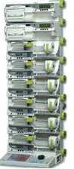

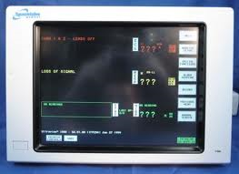
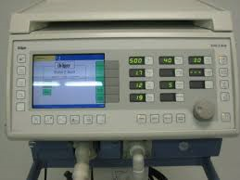
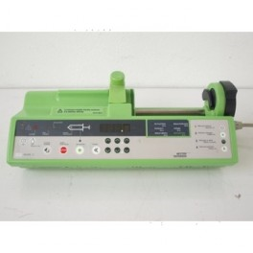
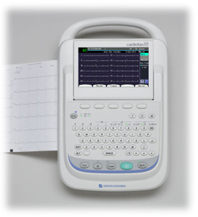
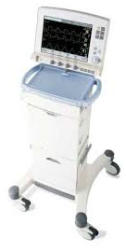
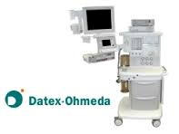

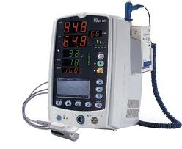
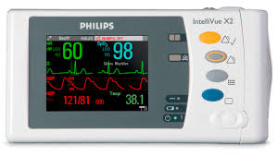
Global biomedical device interoperability
ICU
Anesthesia
Emergency
E P R

Slide 14
ENOVACOM Patient Connect
We offer a global 100% software-based
Interoperability solution
  Manufacturer independant
  EPR software editor independant
  Usable across all units and wards

Slide 15
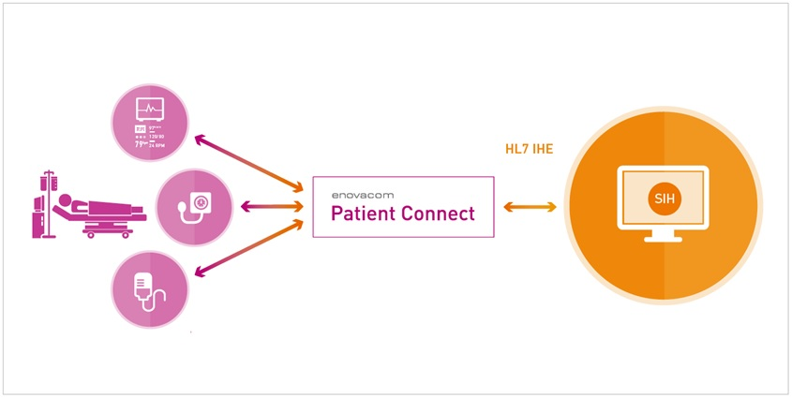


The solution – schematics
The first patient-centric biomedical
Interoperability solution
Communication
Libraries
HIS
Authentication
Identification
Association
EMR, ER Software, OR Software, etc
Monitors, pumps, ventilators…

Slide 16
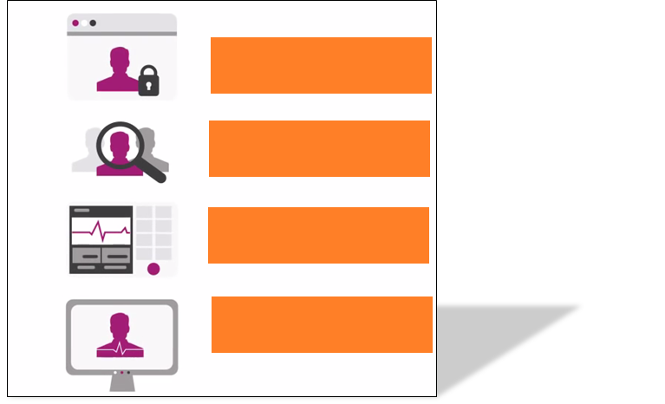
The Workflow
AUTHENTICATE
IDENTIFY
ASSOCIATE
INTEGRATE
Integrate patient vitals securely in your EPR

Slide 17
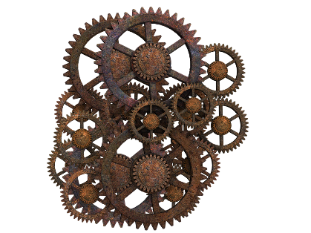

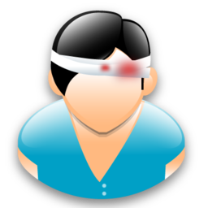

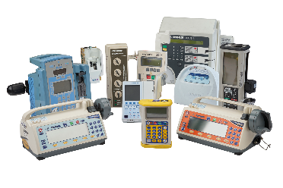
The Repositories
ENOVACOM Patient Connect
Users
Patients
Structures
Devices

Slide 18
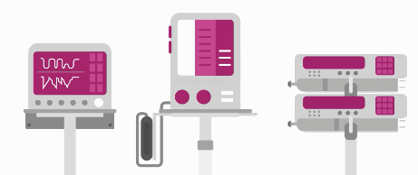
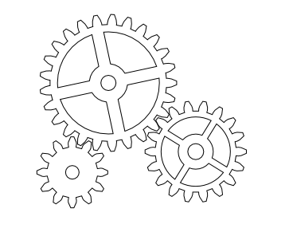
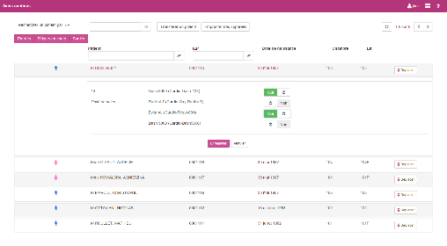
The solution – general schematics
E P R
International
Format
HL7 ORU
Proprietary
Format
Vital Signs
Half connector
ADT
ENOVACOM Patient Connect
Half connector
ADT
IHE PAM
Users
Patients
StructureS
DEVICES
Available contextual link

Slide 19
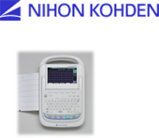
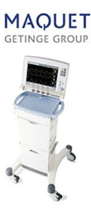
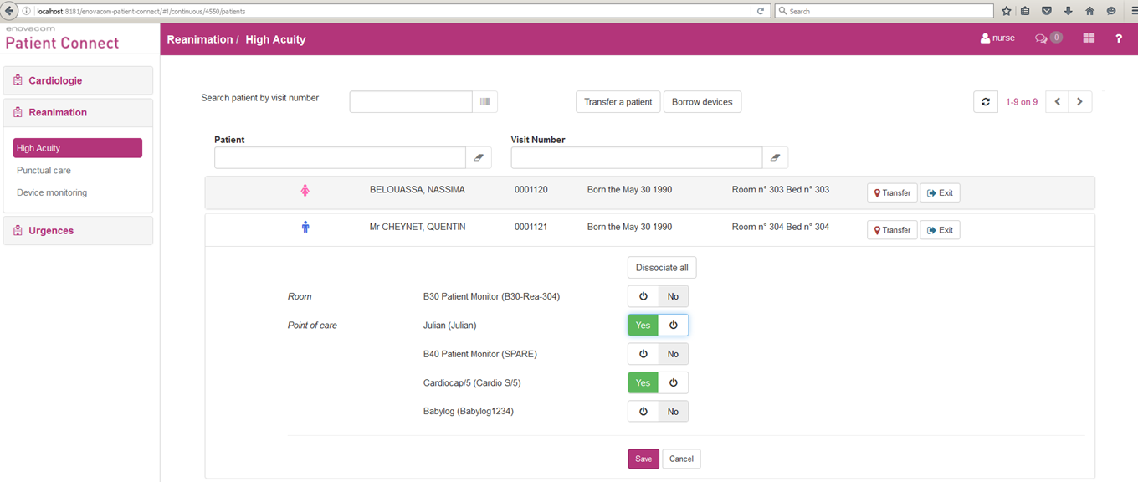
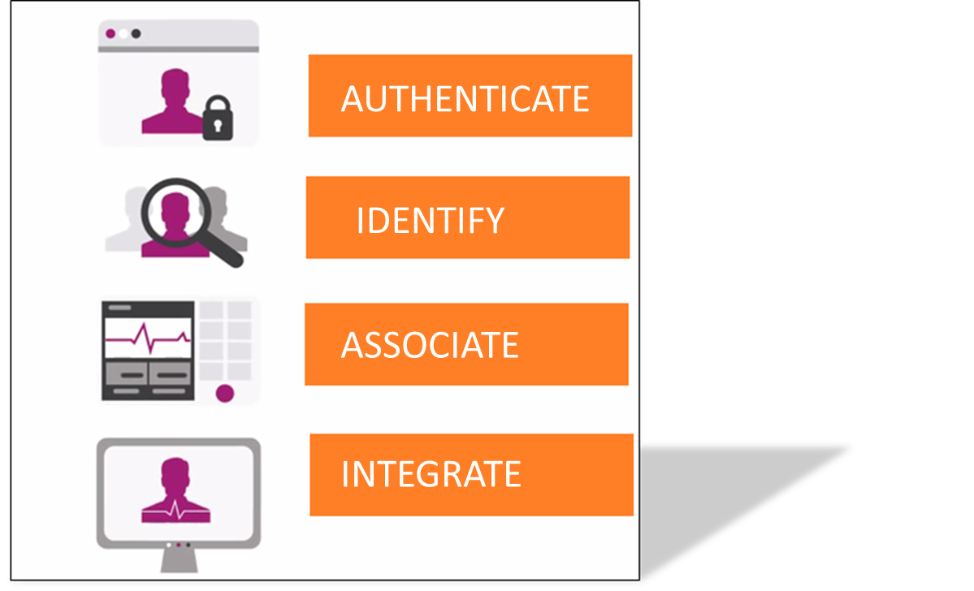
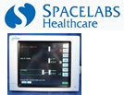
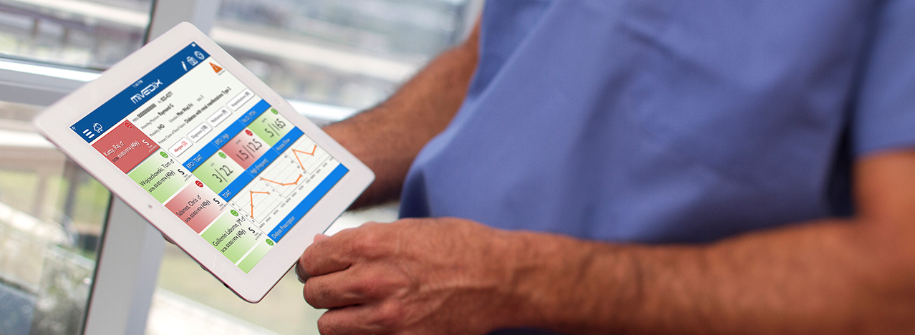
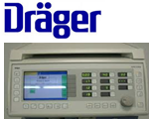
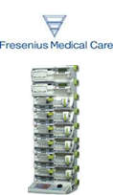
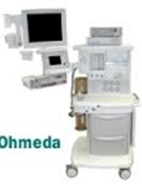

Complet digitisation of patient surveillance
COMPLETE DIGITISATION OF PATIENT SURVEILLIENCE
Patient to Devices Association
Accessed via E-Obs software

Slide 20


Strong interoperability with ALL the players
Software vendors & medical device manufacturers
250+ medical devices available

Slide 21
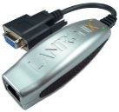
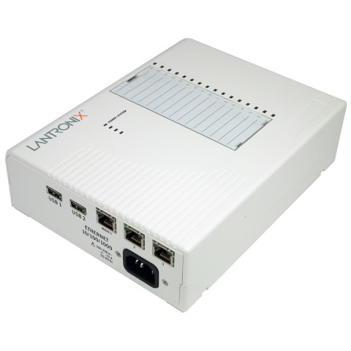
Data Communication
If the equipment does not possess a network port to transmit the data, then we simply add a converter that is commercially available:
  Moxa
  DIGI
  Lantronix
  Perle Systems

Slide 22
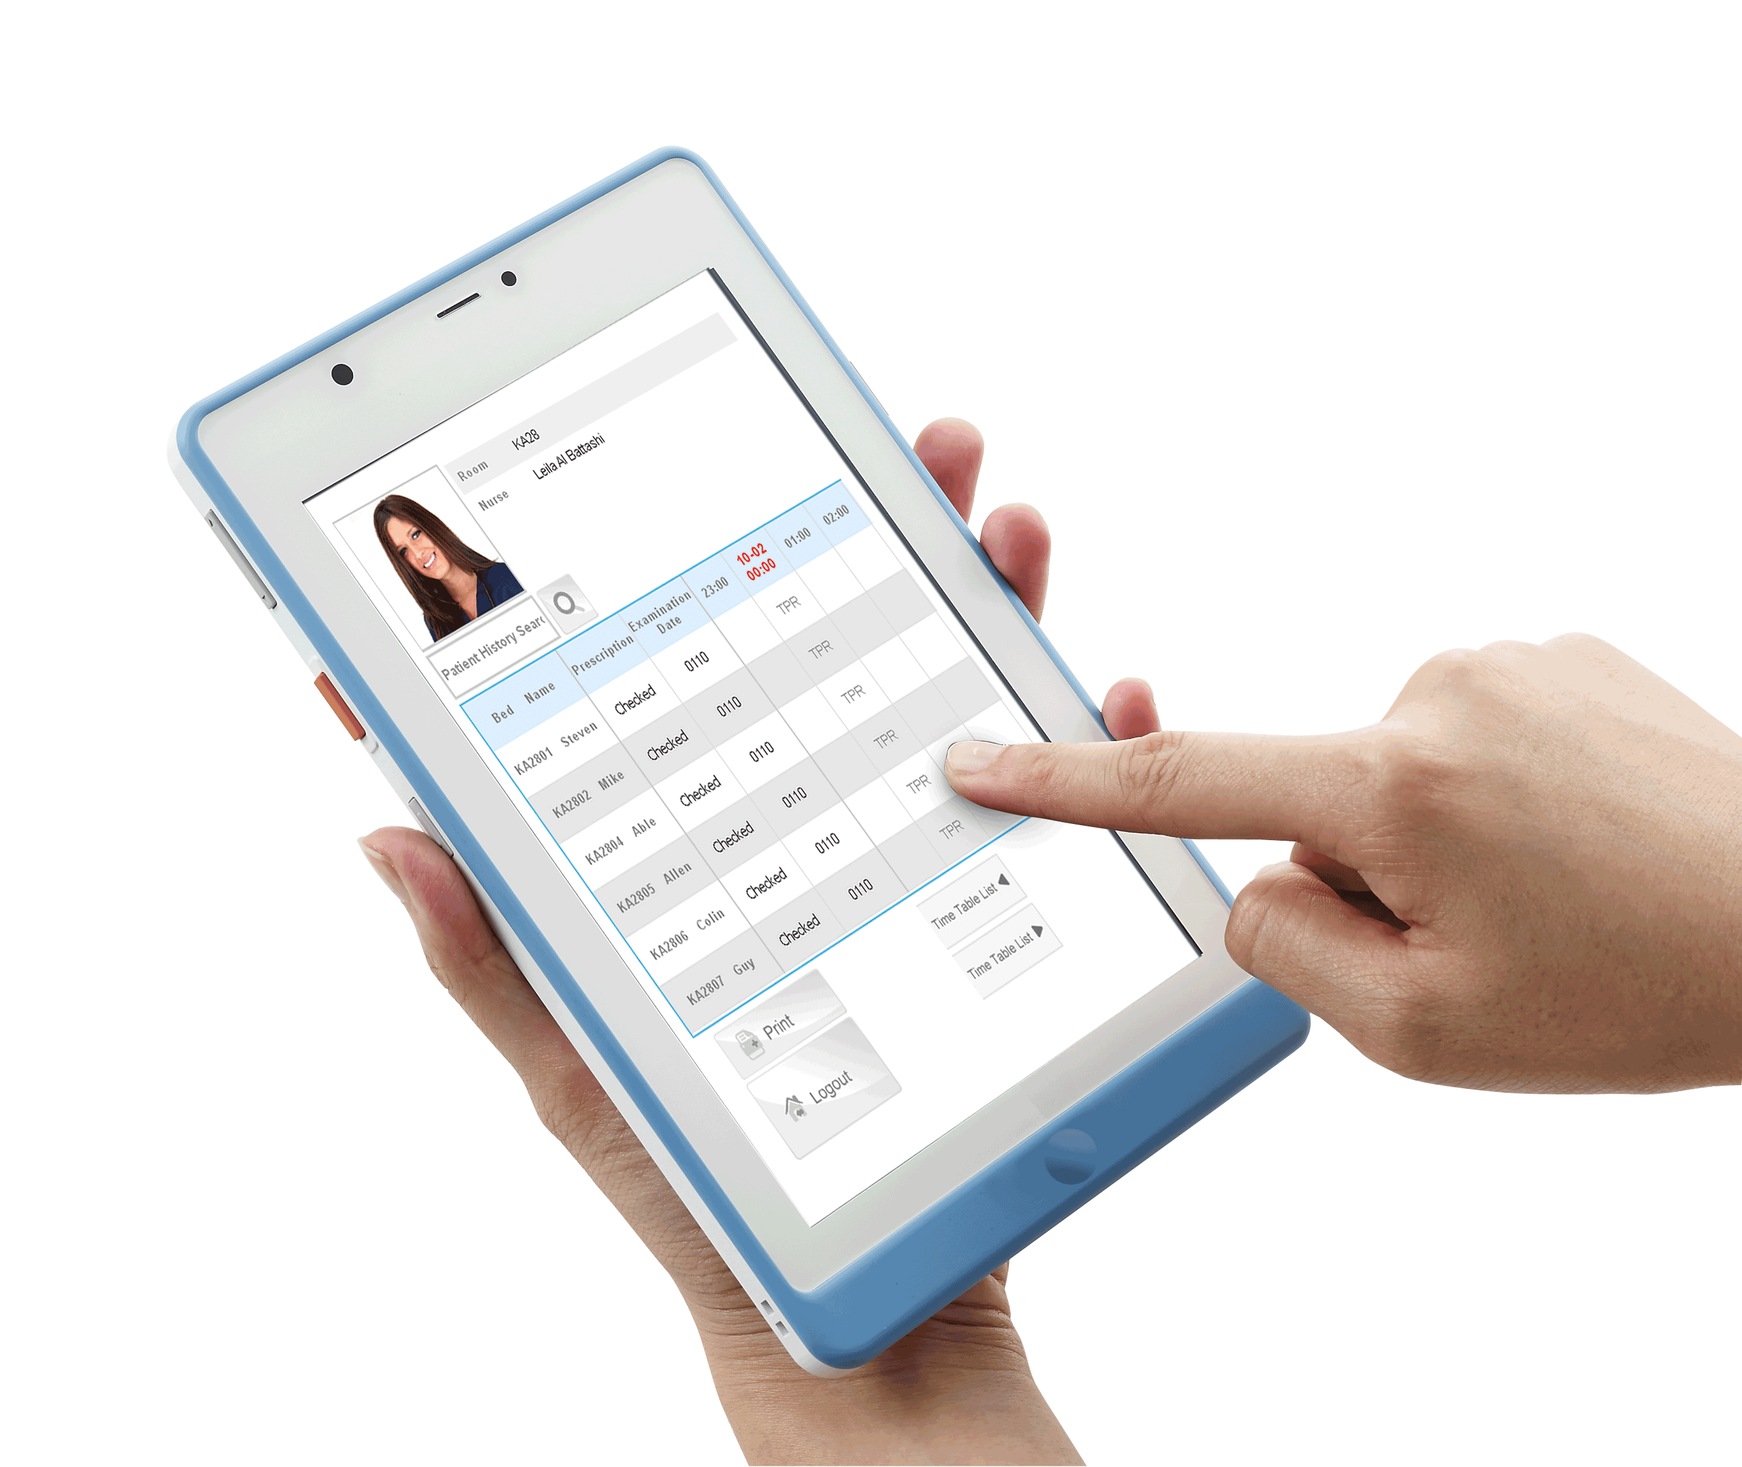
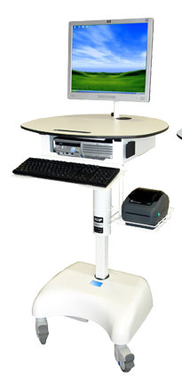
The User Interface
Can be tighlty INTEGRATED to your EPR:
Contextual link
No supplemental login
No need to select the unit/department
No need to select the patient
Our solution is 100% web-based and clientless, so the users can access the solution via :
  PC in the patient room
  PC on a cart
  tablet
  etc

Slide 23

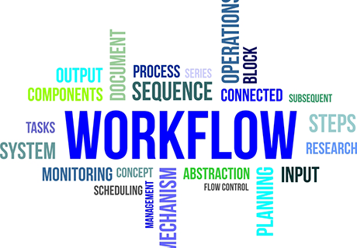
The various clinical workflows

Slide 24
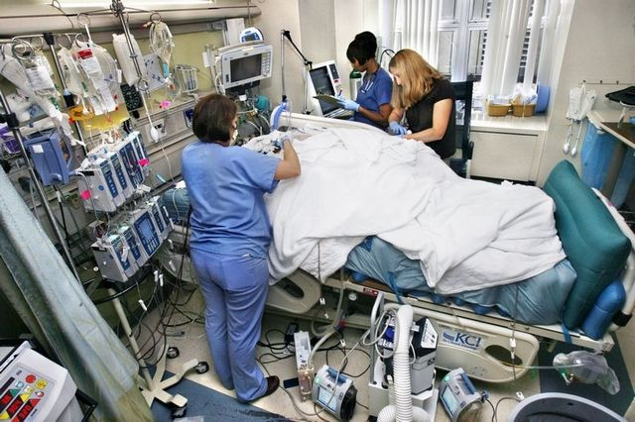
A. Continuous Care Workflow
Patient arrives in ICU

Slide 25
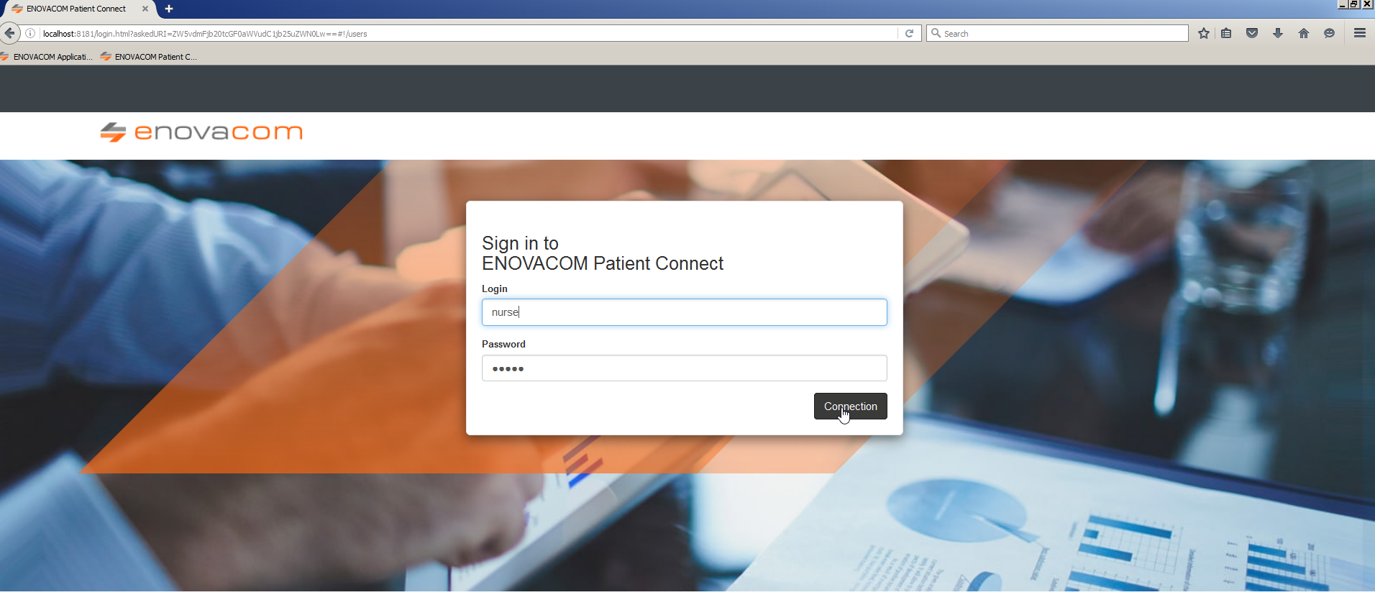
Continuous Care Workflow

Slide 26
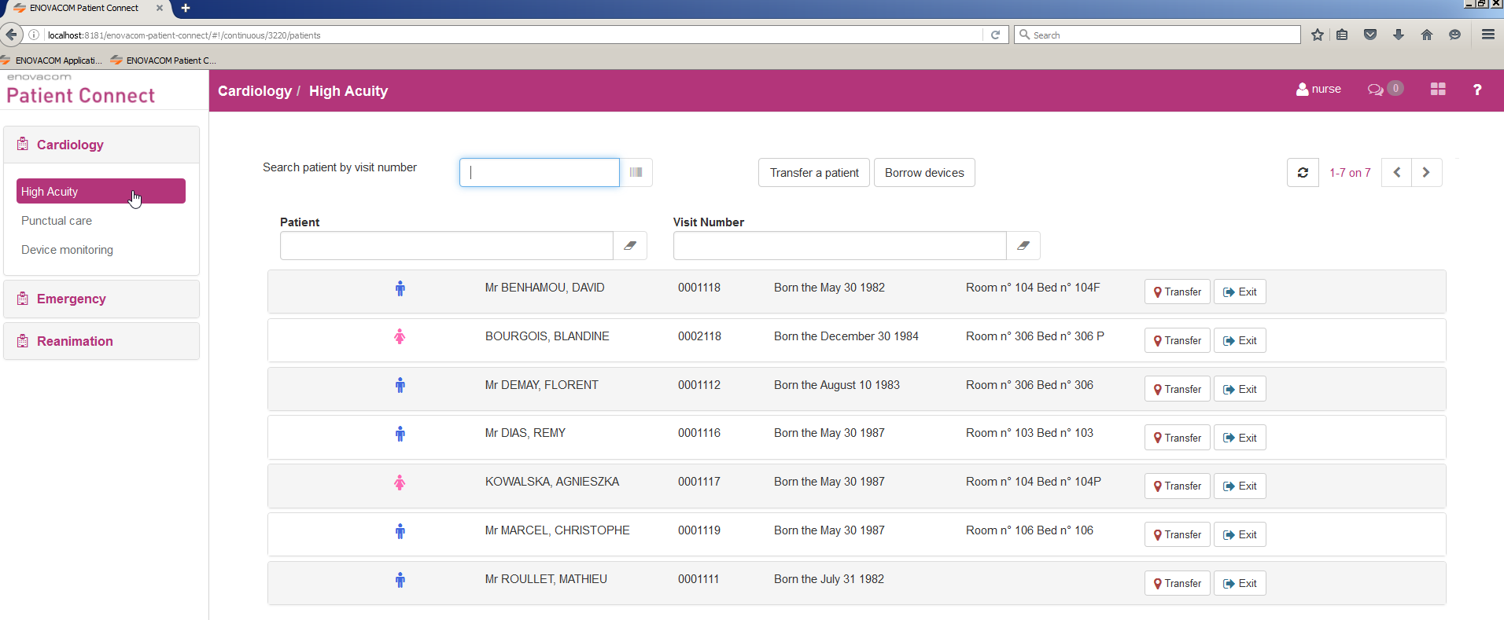
Continuous Care Workflow
2- Nurse selects relevant ward/service

Slide 27
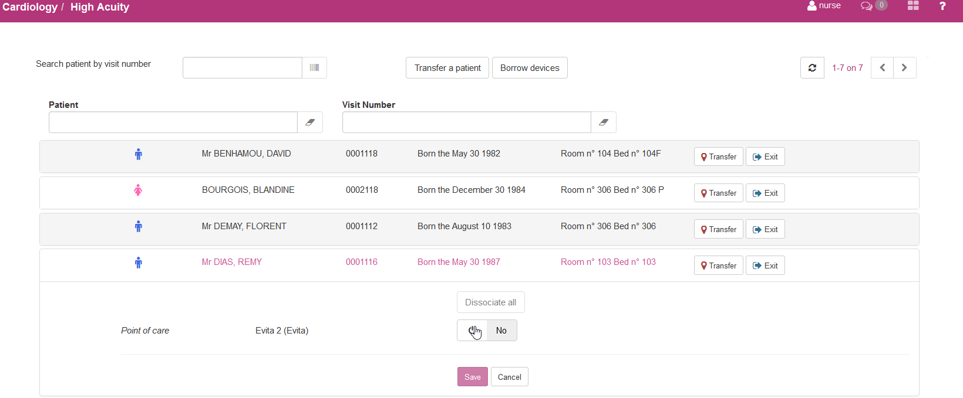
Continuous Care Workflow
3- Nurse selects correct patient in list

Slide 28
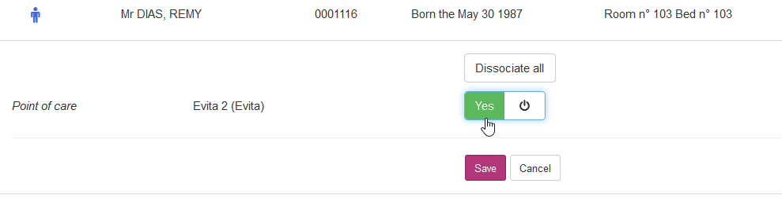
Continuous Care Workflow
4- Nurse associates vital signs device to patient/room

Slide 29
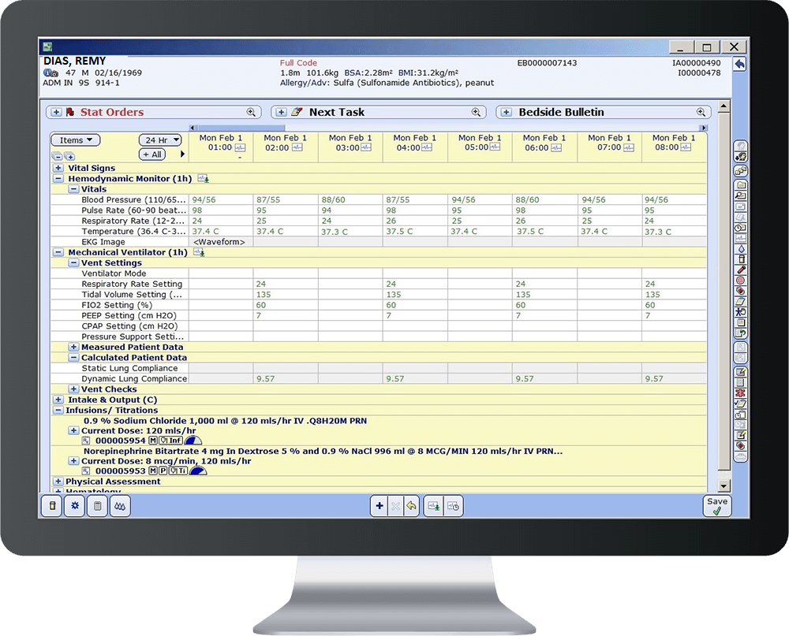
Continuous Care Workflow
Patient vital signs automatically sent to EPR
according to prescribed schedule.

Slide 30
B. Punctual Care Workflow
1- Nurse logs in to Enovacom Patient Connect
Via internet browser

Slide 31
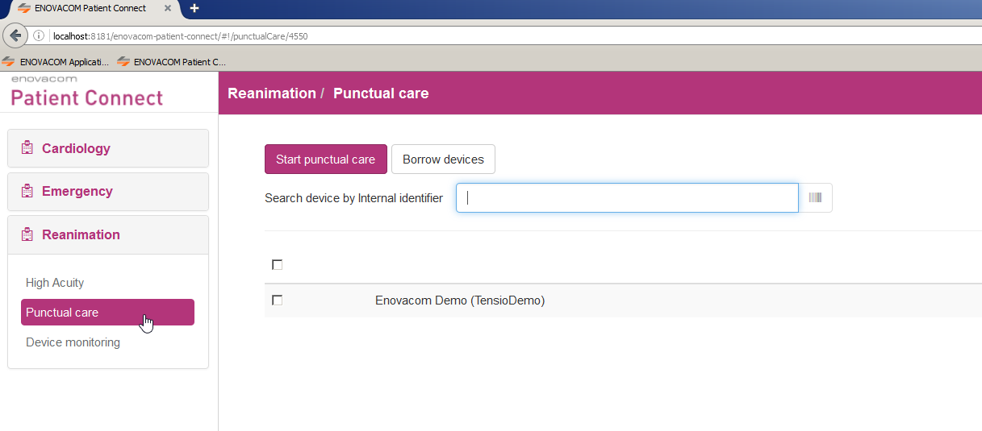
Punctual Care Workflow
2- Nurse selects relevant ward/service
and device used for round

Slide 32
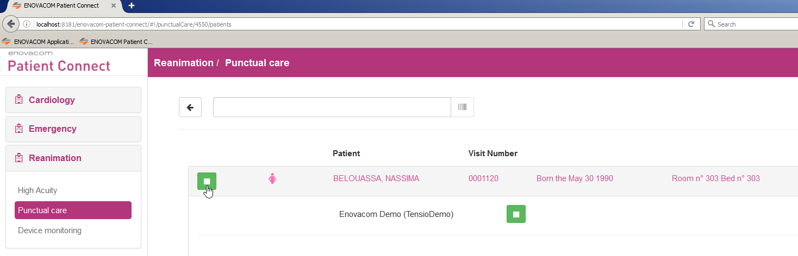
Punctual Care Workflow
3- Nurse selects patient

Slide 33
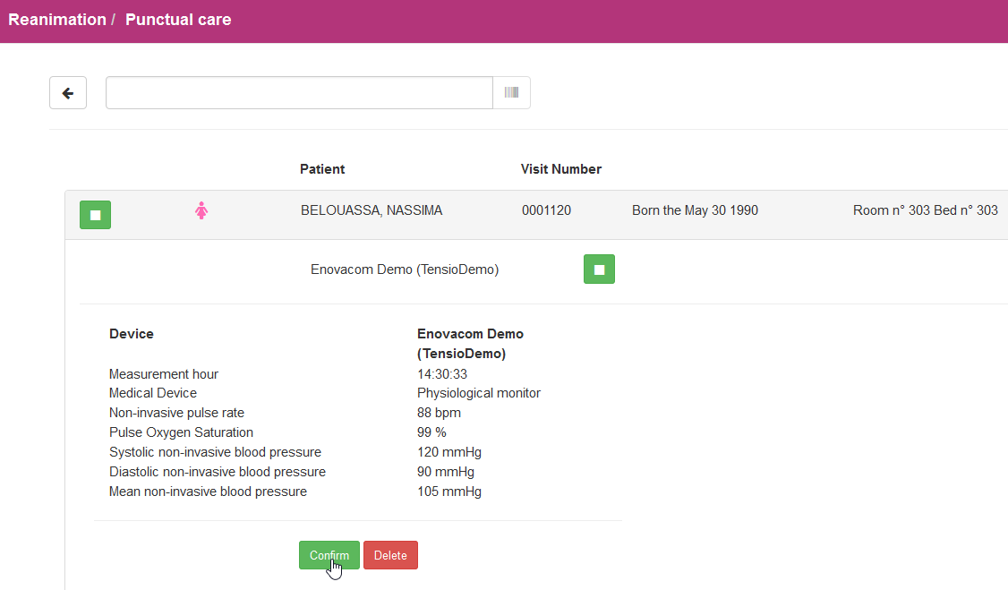
Punctual Care Workflow
4- Nurse activates vital signs device
and confirms the live displayed values

Slide 34

Punctual Care Workflow
5- Data is sent to EPR

Slide 35
D. Contextual Link Integration
Patient arrives in ICU

Slide 36

Contextual Link Integration
1- Nurse is already using EPR

Slide 37
Continuous Care Workflow
2- With selected patient in EPR, nurse clicks on
EPC shortcut
EPC

Slide 38

Continuous Care Workflow
3- EPC window opens up with patient
selected automatically
EPC

Slide 39
Continuous Care Workflow
4- Nurse associates vital signs device to patient/room

Slide 40
Continuous Care Workflow
Patient vital signs automatically sent to EPR
according to prescribed schedule.

Slide 41


Wirral University Teaching Hospital
Hospital introduction
Info
One of the biggest and busiest acute NHS trusts in the North West.
920 beds
One of the 16 digitally advanced acute trusts with Global Digital Exemplar status - recognized NHS provider delivering exceptional care, efficiently, through the use of world-class digital technology and information
CERNER Millennium pilot site, using device connectivity solution from CERNER (I-BUS) for some biomedical devices
Project
WUTH invested £0.5M in brand new SERVO-Air and Servo-U ventilators from MAQUET and the existing device connectivity solution was unable to integrate those devices within the timeframes needed
Enovacom responded with delivered POC within 1 month, project was delivered 2 months later
Benefits
100% software based solution,
Ease to use and to manage by internal staff

Slide 42


Oxford Health NHS Foundation Trust
Initial context
As one of the Global Digital Exemplar chosen by NHS England, OHFT is required to increasingly share data with other NHS organisations in various formats and various duplicated delivery methodology.
NHS 2020 paperless initiative to promote digitalization
Project
POC to train and assist the trust with the first interfaces and gain a high level of autonomy
Benefits
The solution is even more intuitive than what we expected, much more than Intersystems, the short listed solution
The Trust will have the interoperability platform defined and skilled staff to maintain and deliver any interoperability projects.
It will also settle the basis for the future clinical data repository and the web portal for the clinicians

Slide 43

Our latest white paper on medical device connectivity

Slide 44


Thank you for your attention
Mark Smith
contact@enovacom.com
07764 487301
+ 33 (0) 4 86 670 000
Facebook.com/enovacom
www.enovacom.fr
Twitter.com/enovacom_fr
contact@enovacom.com
Linkedin.com/enovacom

